Slide 1
Enterotomy
Dr.Alaa Ahmed Ibrahim

Slide 2
Antomy
carnivore’s intestine is approximately five times the length of its trunk applies reasonably well to dogs and cats
The small intestine measures between 1.0 and 1.5 m in cats and between 2 and 5 m in dogs
The small intestine is composed of the duodenum, jejunum, and ileum and therefore extends from the pylorus to the ileocolic junction
The duodenum is the relatively fixed, short proximal part of the small intestine.
the jejunum, the longest portion of the small intestines

Slide 3
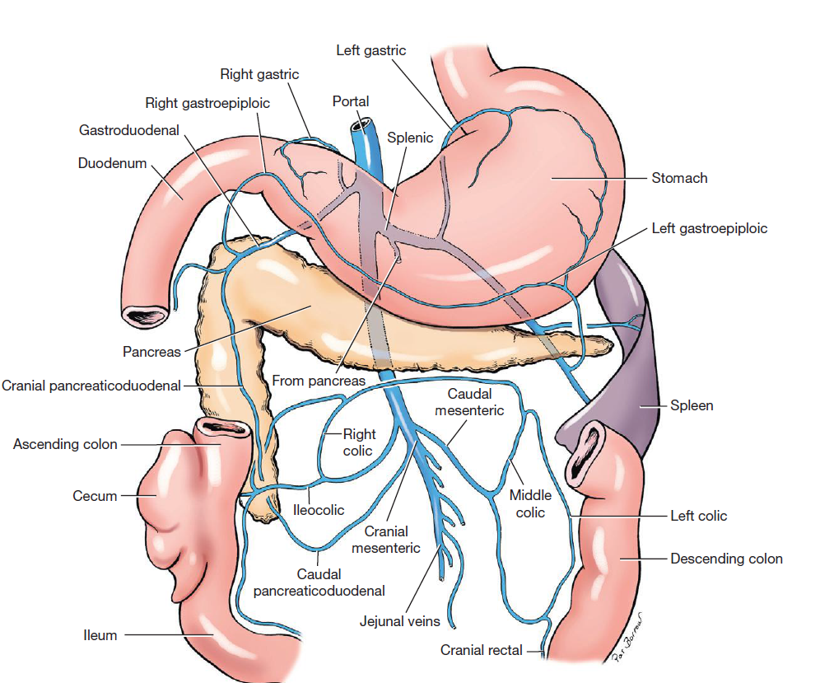

Slide 4
The root of the mesentery includes the cranial mesenteric artery, intestinal lymphatics, and large mesenteric plexus of nerves that supply the small intestine.
Cranial mesenteric artery arises beneath the first lumbar vertebra and anastomoses proximally with a branch of the celiac artery
the cranial mesenteric artery divides into 12 to 15 major branches

Slide 5
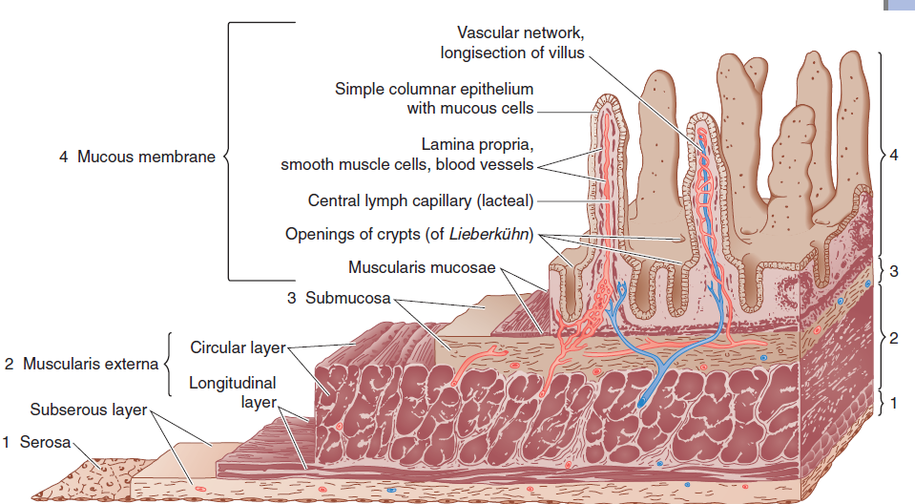
The small intestine is structurally composed of four layers: the mucosa, submucosa, muscularis, and serosa

Slide 6
Enterotomy indication
Foreign bodies
Biopsy samples
A longitudinal incision is made in the antimesenteric border of the bowel immediately distal to the foreign object.
This ensures the suture line is placed in healthy bowel that has not undergone pressure necrosis or distension from presence of the foreign body.
The enterotomy is closed longitudinally in a single layer, appositional pattern with simple interrupted or continuous sutures.
When full-thickness intestinal biopsies are needed for histopathologic evaluation, a longitudinal elliptical incision is made in the antimesenteric border of the bowel

Slide 7
longitudinal closure of the defect compromises the lumen, the defect is closed transversely in a single layer, appositional, simple interrupted pattern

